Slide 1


ICT-3101 | Data Communication
Stream Control Transmission Protocol (SCTP)
Md. Mashrafi Rahman
ID: IT-24034 | 3rd Year, 1st Semester
Department of ICT
Submitted to Dr. Nazrul Islam, Associate Professor, Dept. of ICT
Mawlana Bhashani Science and Technology University
Notes:
Introduce yourself, the course and the topic: SCTP.

Slide 2
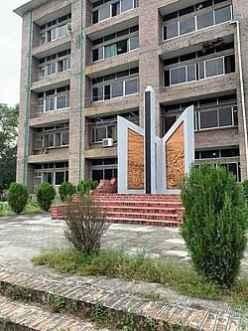
Presentation Outline
01
Introduction to SCTP
02
Limitations of TCP and UDP
03
Multistreaming and multihoming
04
Association setup and packet structure
05
Comparison, applications and conclusion

Slide 3
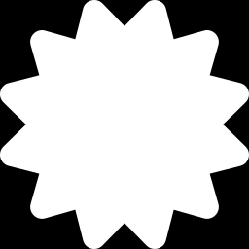


Introduction to SCTP
A reliable, message-oriented transport-layer protocol with multistreaming and multihoming.
Standardized by IETF
Best of TCP and UDP
Streams and paths
Layer 4 protocol: RFC 2960 in 2000, now RFC 9260
TCP's reliability combined with UDP's message boundaries
One association carries several streams over several network paths

Slide 4
Limitations of TCP and UDP
Protocol | Key idea | Relevant limitation
TCP | Reliable, ordered byte stream | No message boundaries, head-of-line blocking, one path
UDP | Fast, connectionless datagrams | No reliability, ordering or congestion control
SCTP | Reliable messages over streams and paths | Less widely supported than TCP
Why SCTP? Reliability, message boundaries, independent streams and failover in one protocol.

Slide 5
Multistreaming
One association, many independent streams
1
Streams
Endpoint A
(Sender)
Endpoint B
(Receiver)
Each stream delivers messages in order
Stream 0
2
Loss handling
Stream 1
A lost message delays only its own stream
Stream 2
3
Benefit
No head-of-line blocking, unlike TCP

Slide 6
Multihoming
One association, several network paths
1
Addresses
Host A
Host B
Each endpoint binds several IP addresses
Primary path
IP 1
IP 1
2
Monitoring
HEARTBEAT chunks check path health
Backup path
IP 2
IP 2
3
Failover
Traffic switches to the backup path

Slide 7
Association Setup
1
2
3
4
INIT
INIT ACK
COOKIE ECHO
COOKIE ACK
Client asks to start an association
Server replies with a state cookie
Client returns the cookie
Server confirms; association is open
Why four steps? The server keeps no state until the cookie returns, which blocks SYN-flood attacks. Closing uses SHUTDOWN, SHUTDOWN ACK and SHUTDOWN COMPLETE.

Slide 8
Packet Structure
Common header (12 bytes)
Source Port (16 bits)
Dest. Port (16 bits)
Key point
One packet can carry several chunks, so control and data travel together.
Each chunk has Type, Flags, Length and Value.
Verification Tag (32 bits)
Checksum, CRC32c (32 bits)
Chunks (variable length)
Chunk 1 (DATA)
Chunk 2 (SACK)
… Chunk n
The Verification Tag identifies the association and guards against blind attacks.

Slide 9
SCTP vs TCP vs UDP
Feature | SCTP | TCP | UDP
Reliable delivery | Yes | Yes | No
Data unit | Messages | Byte stream | Datagrams
Multistreaming | Yes | No | No
Multihoming | Yes | No | No
Connection setup | 4-way (cookie) | 3-way | None
Only SCTP offers both multistreaming and multihoming.

Slide 10
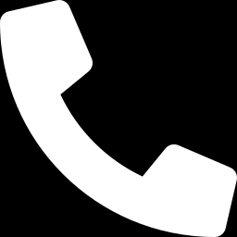
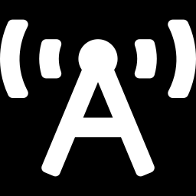
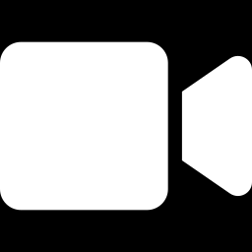
Where SCTP Is Used
Common where reliability and fast failover are critical.
Telecom signaling
4G / 5G networks
WebRTC and Diameter
SS7 over IP using SIGTRAN
Control links such as S1AP and NGAP
WebRTC data channels and Diameter authentication traffic

Slide 11
Conclusion
SCTP adds multistreaming and multihoming to reliable, message-oriented transport.
Strength
Reliable delivery without head-of-line blocking or single-path failure
Limitation
Less supported than TCP; some firewalls and NATs block it
Best suited to
Telecom and systems where downtime is unacceptable
11

Slide 12
Selected References
[1] IETF, “Stream Control Transmission Protocol,” RFC 9260, 2022.
[2] IETF, “Stream Control Transmission Protocol,” RFC 4960, 2007.
[3] IETF, “Stream Control Transmission Protocol,” RFC 2960, 2000.
[4] IETF, “An Introduction to the Stream Control Transmission Protocol (SCTP),” RFC 3286, 2002.

Slide 13
Thank you
Questions and Discussion
Md. Mashrafi Rahman
ID: IT-24034 | Department of ICT
Mawlana Bhashani Science and Technology University

